Slide 1
Data Science Fundamentals
Decision Trees

Slide 2
Before we get started…
Practicalities

Slide 3
Learning objectives
You understand and apply different types of regression, know when and how to use them, can execute them and put them in to practice as well as interpret the results.
You recognize overfitting in regression models and learn techniques to prevent overfitting.
You learn about different clustering techniques and understand when and how to use them for grouping data.
You gain an understanding of dimensionality reduction techniques and learn how to apply
them to compress and visualize data.

Slide 4

Course material
Canvas
  Slides & exercises from classes
Online
  https://www.w3schools.com/datascience/
Software
  JupyterLab (or work via Anaconda/VS Code if you prefer)
The Internet

Slide 5
Course breakdown
Course Structure:
  Lectures: 3 hours per week (theory and exercises)
  Attendance: Mostly not compulsory, but strongly recommended.
Examination Breakdown:
  30%: Continuous assessment (mandatory excercises)
  70%: Final exam (oral, mostly theoretical with some practical elements)

Slide 6

Is it difficult to pass?
It’s perfectly doable if you put in the work
Come to class
Participate in the lessons
Make your exercises

Slide 7
How to be an ideal student
Attend classes - even when you party hardy
Show respect - towards your instructor and fellow students
Be punctual - or you'll find the door closed
Meet deadlines - late submissions will earn a solid zero
Have a question? - just ask! I don't bite
Know it all? - help your classmates, they might repay you with pizza
Do your own work! - shortcuts will lead to a short academic career ;)

Slide 8
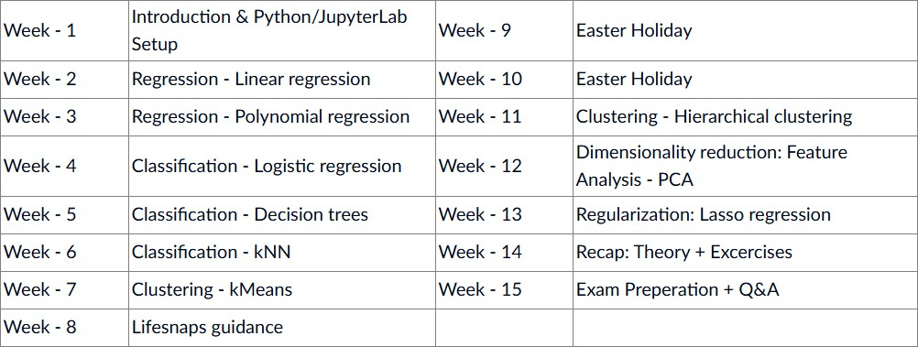
Syllabus
(subject to change)

Slide 9
Now we get to the fun part
Decision Trees

Slide 10
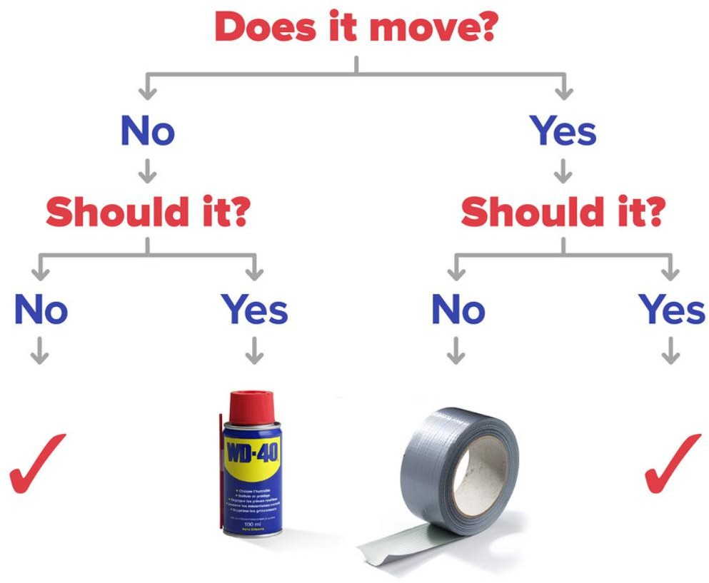
Decision trees
Basically a flowchart
Mimics human decision making
Sever ‘splits’ where you ask a question
Based on the answer you ask further questions
Keep going till you end up with your answer!
Notes:
You will just ask a question about your data => Keep asking until the model knows

Slide 11
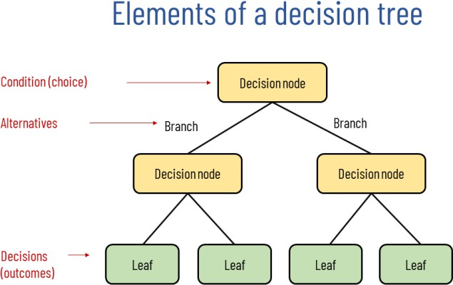
Terminology

Slide 12
Inner workings
Each split is based on one or two variables
Split so as to maximize information gain
  Each split must deliver information gain
We keep asking questions, but hold two important things in our mind:
  How is the split condition determined?
  When should we stop?
  → see lecture Regularization
Notes:
Ok ok trees, ptsd from programming advanced
But how?
Each split is a question: is this variable x or y? Bigger or lesser? Faster or slower?
Though you can keep asking: faster than 30 km/h? No? Faster than 29 km/h? etc.
Every question must give you new relevant information.

Slide 13

Overfitting
We don’t have to worry about this since it’s classification and python will take care of this right?
Actually, we do…

Slide 14

Recognize overfitting
Overfitting occurs in all data science models, even in classification
Also in Logistic regression, even though we (mostly) glossed over it
A model can ask too many questions/the wrong questions
Compare testing accuracy vs training accuracy
High accuracy on training data
+ low accuracy on testing data
= overfitting!
Notes:
Just use the test / train split!
Decision trees is the classification model that is most suceptible to overfitting! So beware!

Slide 15

Combat overfitting
Same fix as ployomial regression:
  Keep polynomial degree low
  Keep amount of nodes low
The fewer questions a model asks, the more it needs to learn from those questions
Learning trends > recognizing values
Notes:
So how to we combat overfitting?
Do like the mafia: don’t ask too many questions.
Same in decision trees: the fewer questions you have to ask, the fewer decisions the model can have to specifically learn it. So it has to value every decision!

Slide 16

Metrics
The same classification metrics apply:
  Accuracy
  Precision
  Recal
  Specificity
  F1 Score
Notes:
You can perfectly compare these metrics to a decision tree model and a logistical regression model!
They after all are the same thing: logistical regression!

Slide 17
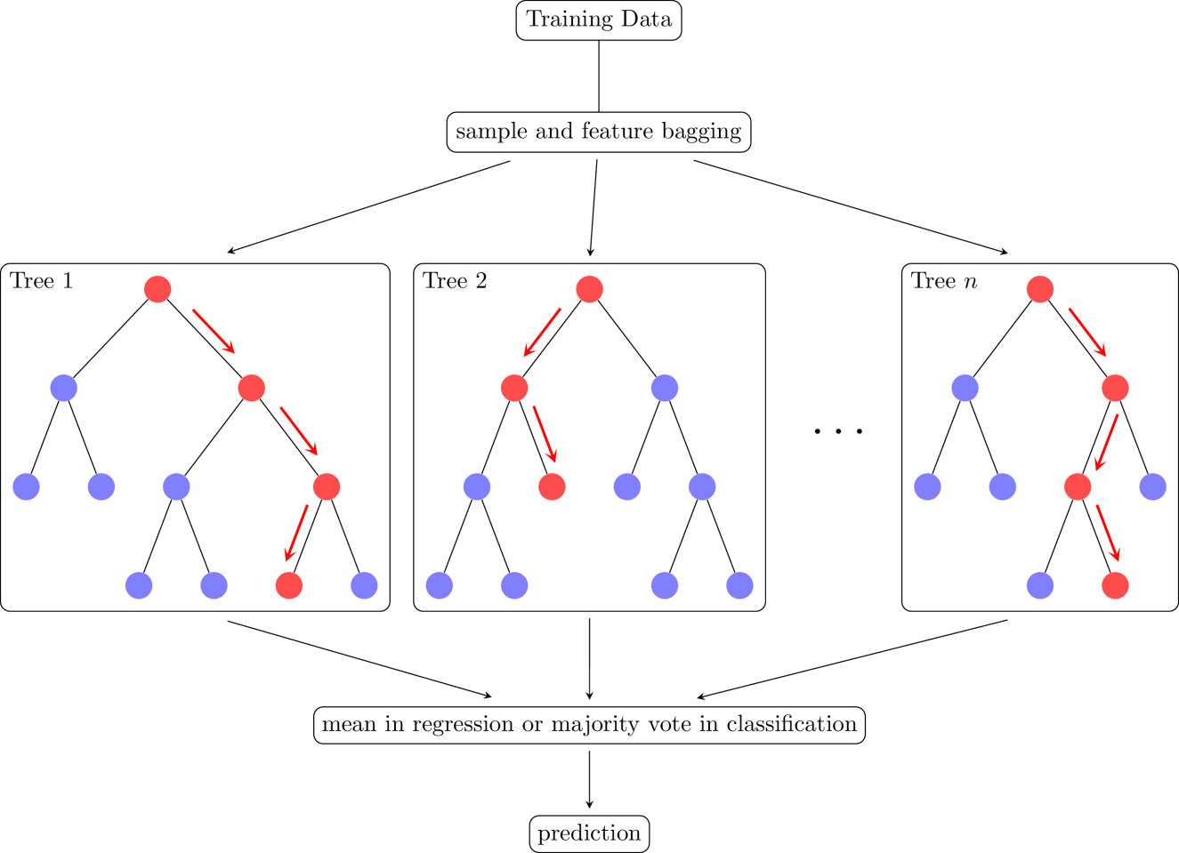
Random forest
Extended form of a decision tree
Chain of decision trees
Each tree:
  Gets a subset of data
  Makes a prediction
Majority vote
Can also be used for regression!

Slide 18
Let’s jump into action
Excercises

Slide 19

First, let’s explore this together
Go to canvas and download the notebook “DSF 05 – Decision Trees Notebook”
Open the notebook in Jupyter
  Open a CMD and run “jupyter lab”
  Or launch it via anaconda
Follow along!

Slide 20

Now it’s up to you!
Go to canvas and download the notebook “DSF 05 – Decision Trees Exercise”
Also download the csv file called “Wine.csv”
Place them in the same directory
Open the notebook in Jupyter
  Open a CMD and run “jupyter lab”
  Or launch it via anaconda
Go through the notebook and make the excercises
I don’t bite, ask me any questions you have!

